Slide 1
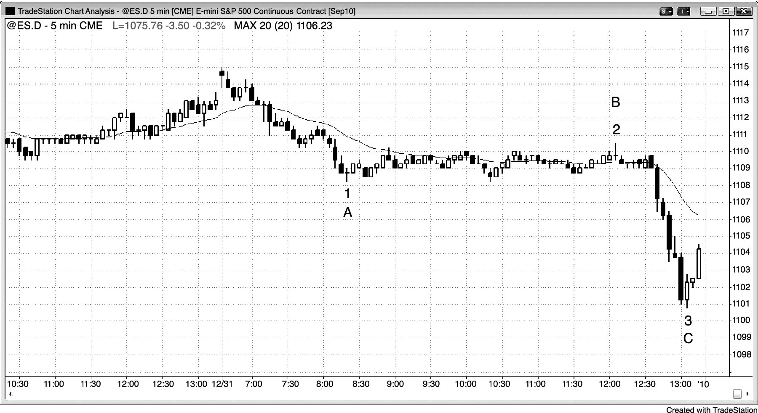
FIGURE 1.1 Extreme Trading Range and Trends

